Slide 1
Movie Ticket Bookig System “Movie mate”

Slide 2
CONTENTS
INTRODUCTION
PROBLEM DEFINITION
MOTIVATION
OBJECTIVES
5. GOALS
REQUIREMENT SPECIFICATION ANALYSIS
NAME OF ALGORITHM
DATA FLOW DIAGRAM
9 . FUTURE SCOPE
10. SNAPSHOT
11. REFERENCES

Slide 3
INTRODUCTION
MovieMate is a simple system to book movie tickets easily for events. It helps people choose movie times and seats without any confusion or double bookings.

Slide 4
PROBLEM DEFINITION
Old movie info can cause confusion and double bookings. Seat booking mistakes may happen due to system or manual errors.
Some apps or sites are hard to use, especially on phones.

Slide 5
MOTIVATION
No need to go to the theater – book tickets online anytime.
Saves time and shows real-time info on movies, seats, and prices.
Easy and safe to use for both users and theater staff.
.

Slide 6
objective
The system lets users easily check movies, showtimes, and book seats online. It helps with safe payments, booking history, and managing reservations. It also helps cinema staff handle schedules and works well on all devices.

Slide 7
GOALS
Make movie ticket booking fast and easy with real-time updates and fewer manual steps.
Let users create accounts, check bookings, and manage their profiles with ease.
Help cinema staff manage movies, seats, and prices while cutting down on physical counters and effort.

Slide 8
REQUIREMENT SPECIFICATION ANALYSIS
SOFTWARE REQUIREMENT
Operating System windows 10
Database MYSQL
Programing Language HTML,CSS, JS, PHP, XAMPP
HARDWARE REQUIREMENT
Processor Intel core i5
RAM 8-16GB
Storage 256GB
System Type 64-bit operating system

Slide 9
NAME OF ALGORITHM
User Registration Algorithm Name: RegisterUserAlgorithm Purpose: Handles new user sign-ups, stores user info securely, and generates login credentials.
User Login Algorithm Name: UserAuthenticationAlgorithm Purpose: Verifies user credentials and grants access to the system.
Movie Listing Algorithm Name: FetchMovieScheduleAlgorithm Purpose: Retrieves and displays the list of available movies, showtimes, and theater info.

Slide 10
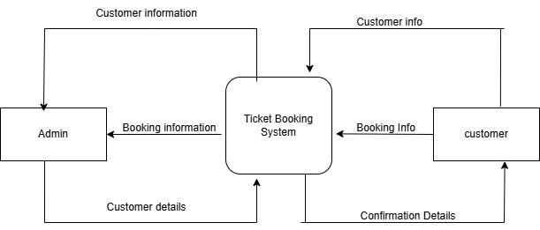
0 - LEVEL DFD
DFD (DATA FLOW DIAGRAM)
.

Slide 11
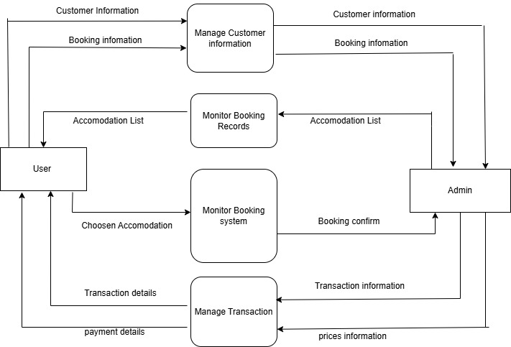
1 – LEVEL DFD
.

Slide 12
FUTURE SCOPES
Add options like ordering snacks and using QR codes or face scan for quick entry.
Suggest movies based on what users like and make a mobile app for easy use.
Support many languages and use AI for smart help and chat support.

Slide 13
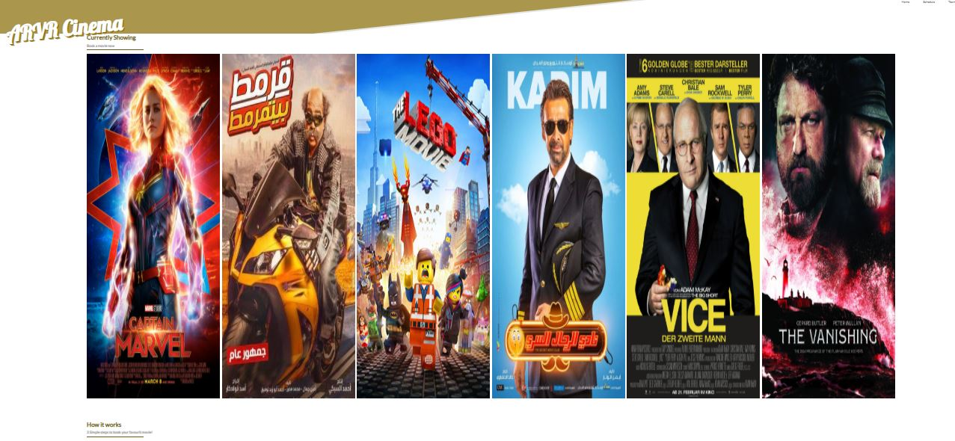
SNAPSHOT
.

Slide 14
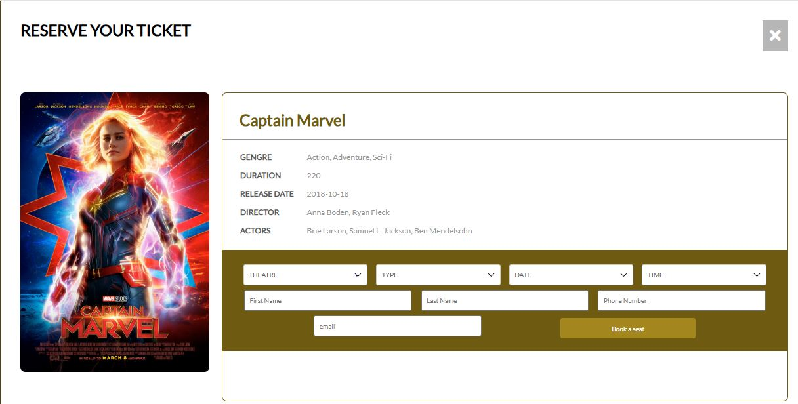
Movie booking
.

Slide 15
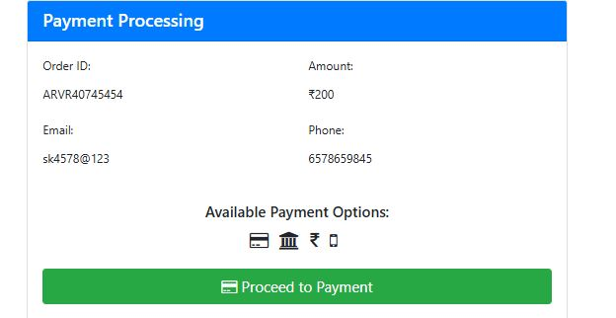
Payment Processing
.

Slide 16
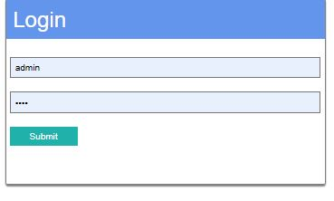
Admin login
.

Slide 17
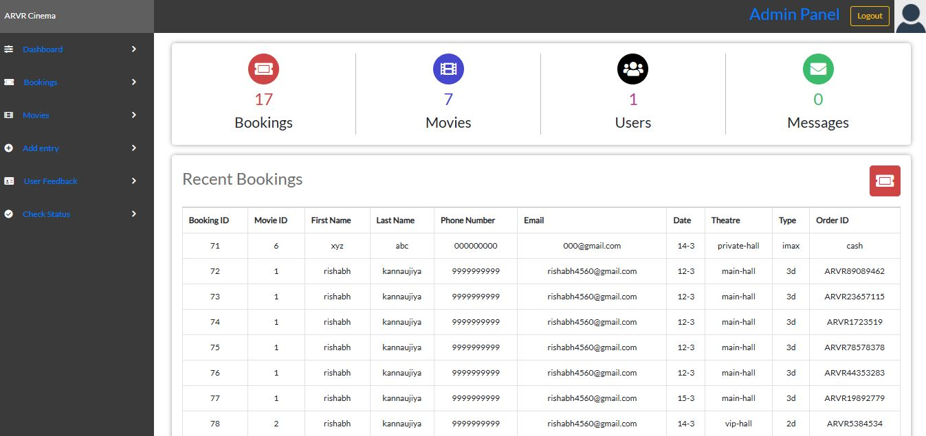
Dashboard
.

Slide 18
References
Online Movie Ticket Booking System. (n.d.). Retrieved from https://www.geeksforgeeks.org

Slide 19
Thank you

